Slide 1





MAMC01803 Analytics for Managers
Week 4 (Session 2): Diagnostic Analytics

Slide 2

In this lecture:
Assessment Two
Topic 1: (Continued) Exercises of diagnostic analytics

Slide 3
Chi Square Test
A Chi-square test is a way to see if there is a connection between two variables or if something happens by chance.
It compares what actually happened (observed values) with what you expected to happen (expected values) with what actually happens.
Helps you figure out if the difference is significant or not in the observed (actual) values.

Slide 4
Chi Square Test
Example: You want to see if gender influences movie genre preference (horror VS romance) or if the preferences are the same regardless of gender.
You will create 2 tables: 1) Observed values: The actual number of males who watch horror and romance, and the actual number of females who watch horror and romance (this comes from your dataset). 2) Expected values: your expected number of males who watch horror and romance, and expected number of females who watch horror and romance (this needs to be calculated).
Formula to calculate expected values: row total * column total / grand total

Slide 5
Correlation
The purpose of correlation is to measure the relationship or connection between two variables.
It helps to determine whether and how strongly two variables are related.
Correlation can tell you if an increase in one variable is associated with an increase (or decrease) in another variable.
Example: increase in temperature increases jacket sales (positive correlation). Increase in exercise decreases weight (negative correlation).

Slide 6
Correlation
To perform correlation:
1) calculate correlation coefficient (r) which measure the degree of relationship between the 2 variables. If r is close to 1, there is a very strong positive relationship between the 2 variables. If r is close to -1, there is a very strong negative relationship between the 2 variables.
2) perform regression to get p value to test the significance. If p value is less than or equal to 0.05, then the correlation is significant.
E.g. If r = 0.80 and p value = 0.02, there is a statistically significant very strong positive relationship between the 2 variables.

Slide 7
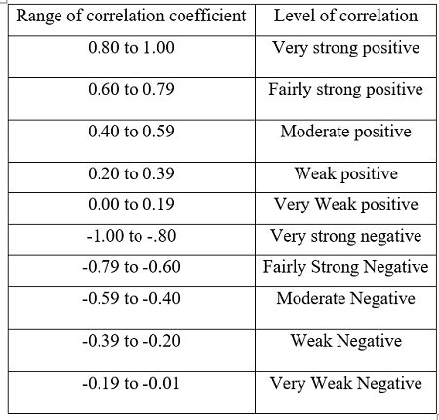

Slide 8
Diagnostic analytics
Please complete the following tasks:
Read the materials about Chi-square/Correlation (see our Teams group)
Use the data set provided on teams to run chi square and correlation
Write the interpretation of the results in a word document
Upload your files on Teams Files-> class activities-> Week 4 Session 2

Slide 9
Useful readings
1. How to report statistics in APA style:
2. How to do t test in Excel:
3. How to do ANOVA in Excel:
4. How to do video and the explanation of Chi-square tests in Excel:
5. How to do Correlation in Excel:

Slide 10
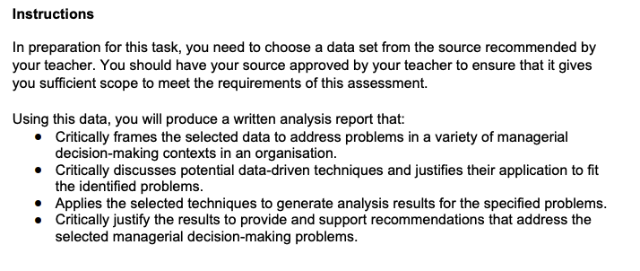
Assessment Two

Slide 11
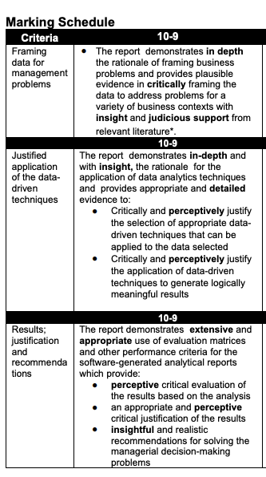
Assessment Two
Word count guidance: 3000 words
Due date: Monday Week 9 (7 April 2025), 9:00 AM

Slide 12
Homework
Categorize your variables from the dataset as categorical or numerical.
Identify 3 business problems from your dataset that you would like to address.
Perform descriptive analysis (descriptive statistics, pivot tables, graphs etc) on your dataset to address your problem(s). Interpret the analysis results.
Perform diagnostic analysis (t-test, ANOVA, chi-square test, correlation with regression) on your dataset to address your problem(s). Interpret the analysis results.

